Slide 1


Dr : Hala Hamdoun
LSTM TIME SERIES FORECASTING
By:
Remas Alqahtani 221505796
Sara Rasheed 220015150
Sara Almugarab 218034114

Slide 2

OVERVIEW
01
02
03
Introduction
summary of code
charts
04
05
06
predictions
Modules
Conclusion

Slide 3
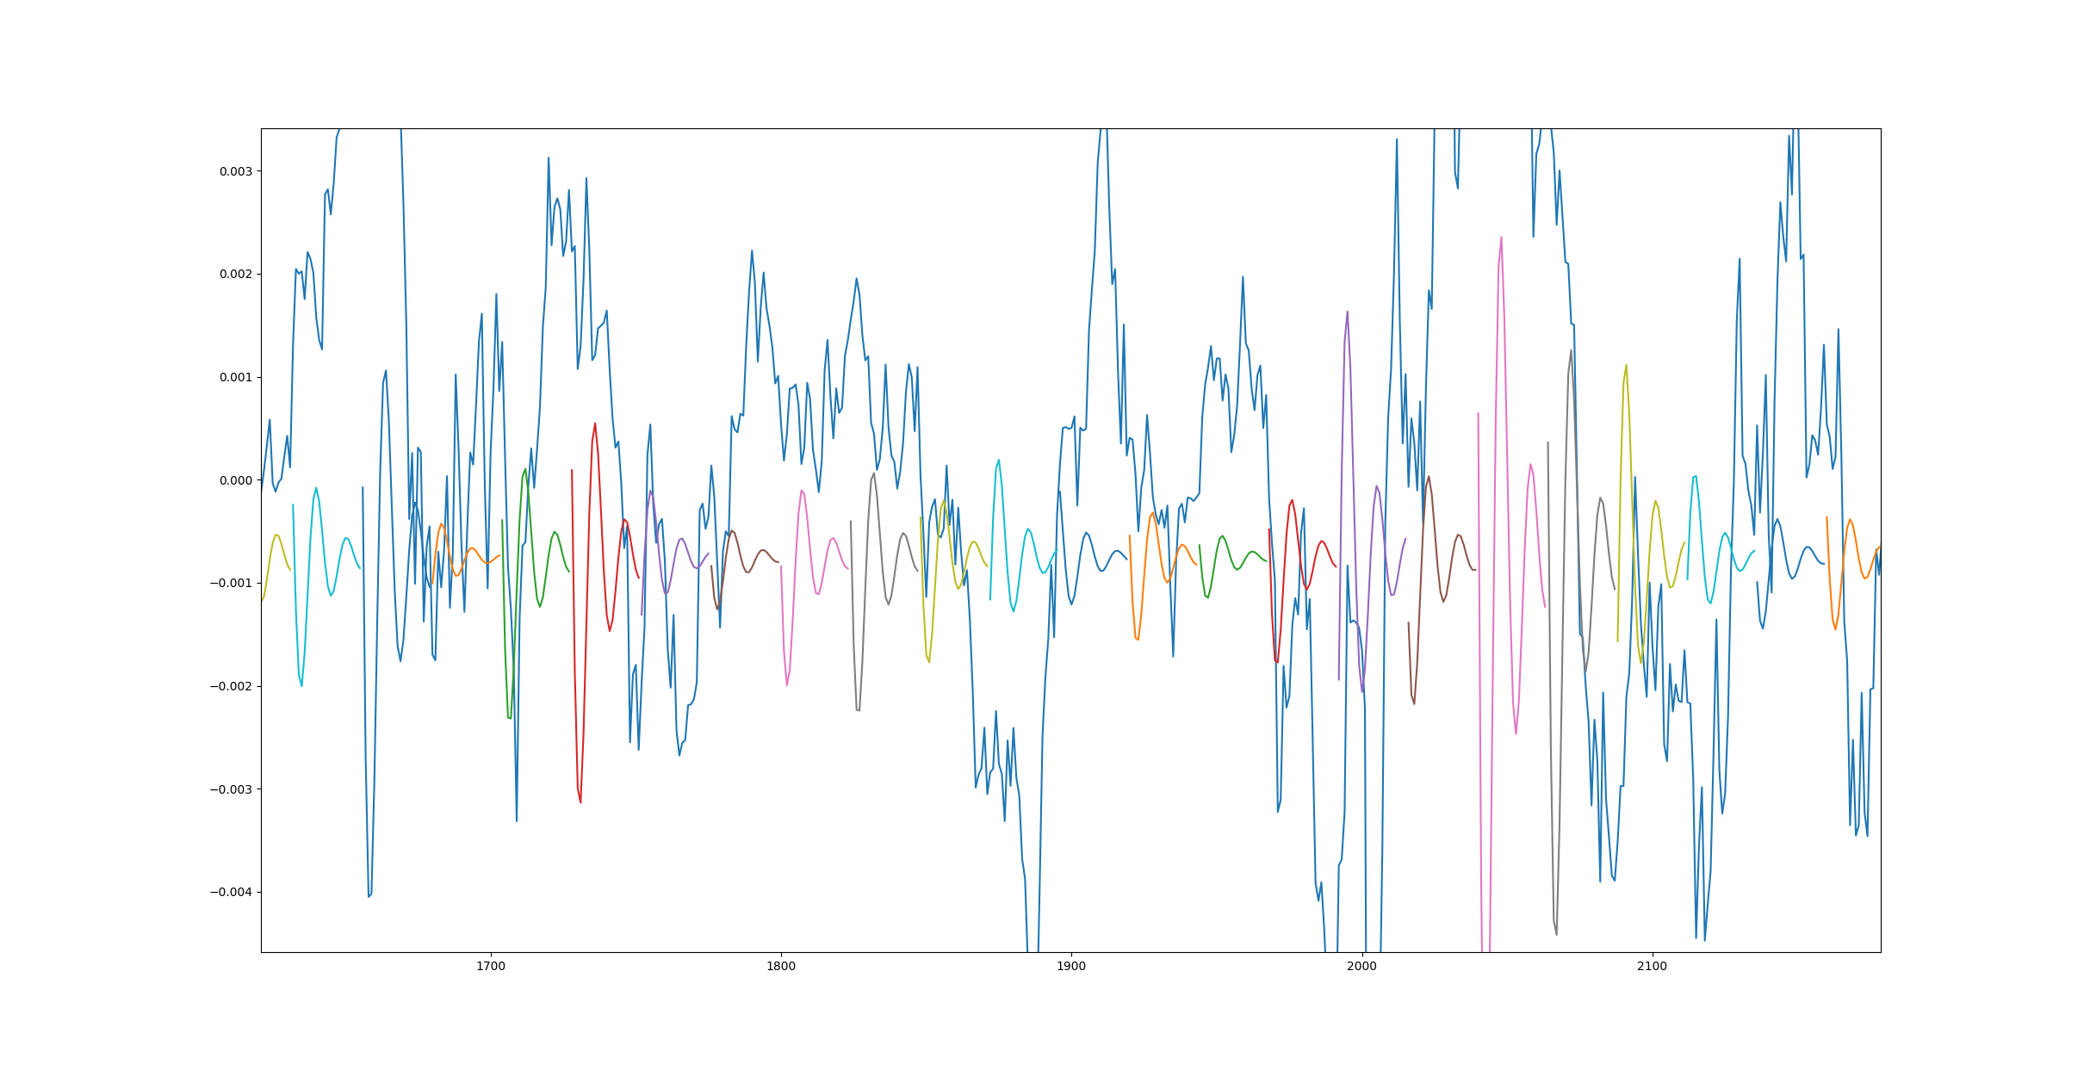


INTRODUCTIONS
LSTM Time Series Forecasting uses LSTM networks to predict future values from historical data. It involves steps like data preprocessing, model construction, training, prediction, and evaluation.
LSTM is used in financial prediction, weather forecasting, sales estimation, and energy forecasting. For example, it can predict a company's stock price based on past data.
Benefits of LSTM include capturing long-term dependencies, efficient handling of sequential data, and flexibility for various datasets.

Slide 4


SUMMARY OF CODE
This code demonstrates time series forecasting using weather data. It involves creating several deep learning models using TensorFlow and Keras to predict temperature and pressure. The process includes
Data Loading and Preprocessing: Downloading a dataset, cleaning it, and converting time-based data into cyclic features.
Windowing for Sequential Data: Breaking down the time-series data into sequences for model training.
Model Training: Implementing different neural network architectures (LSTM, GRU, Conv1D) for time series prediction.
Evaluation and Visualization: Plotting model predictions against actual values for train, validation, and test sets.

Slide 5

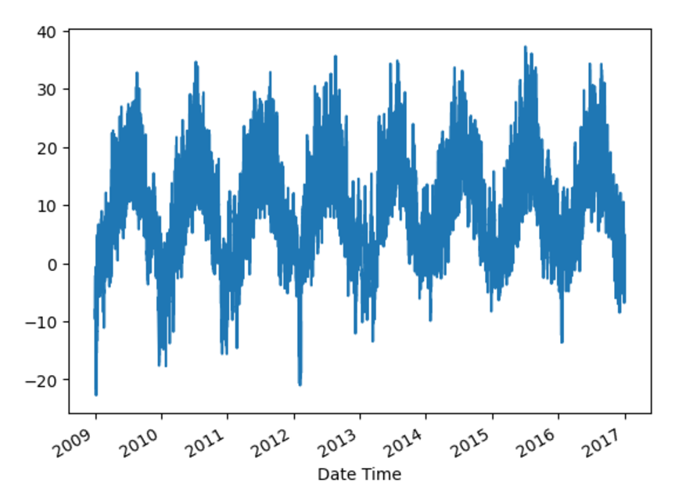
Chart
select a column'T (degC)' :
the code snippet extracts temperature data from a DataFrame and creates a line plot to visualize its temporal variation. The plot reveals a clear seasonal pattern in the temperature data.

Slide 6

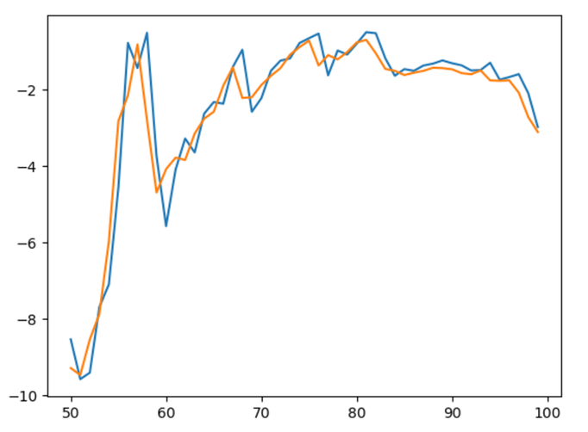
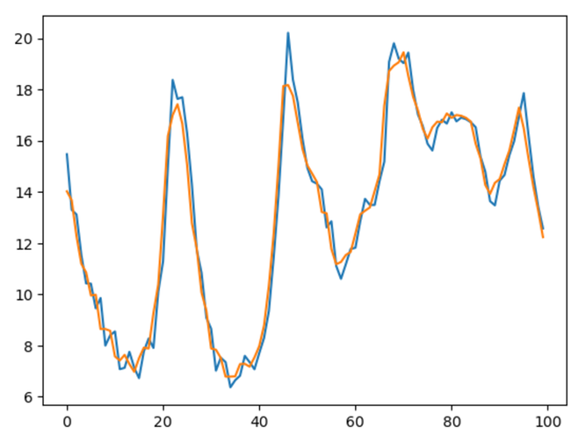
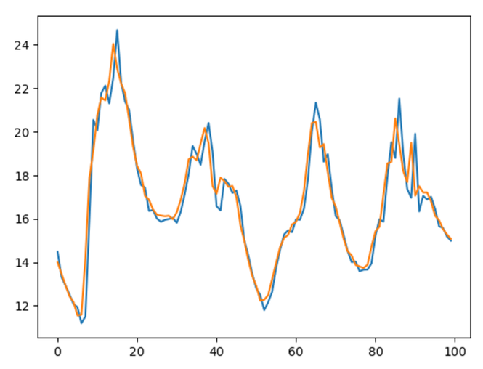
PREDICTIONS
Train predictions
Validation predictions
Test predictions
the code is train predictions snippet creates a line plot to compare the predicted and actual values from a model's training results. The plot reveals that the model captures the overall trend but struggles with predicting sharp fluctuations
the code is Validation predictions snippet creates a line plot to compare the predicted and actual values from a model's validation results. The plot reveals that the model captures the overall trend but struggles with predicting sharp fluctuations.
the code is Test predictions snippet creates a line plot to compare the predicted and actual values from a model's validation results. The plot reveals that the model captures the overall trend but struggles with predicting sharp fluctuations.

Slide 7

Modules
Convolutional Neural Network
(CNN)
Gated Recurrent Unit
(GRU)
Long Short Term Memory
(LSTM)

Slide 8


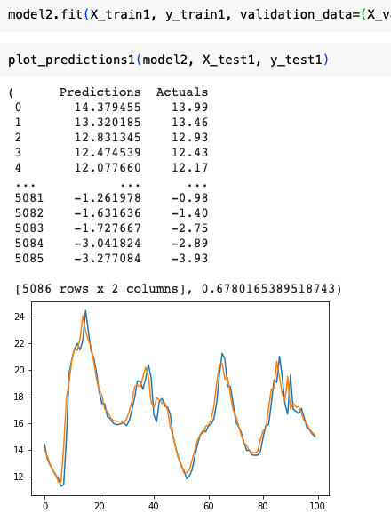
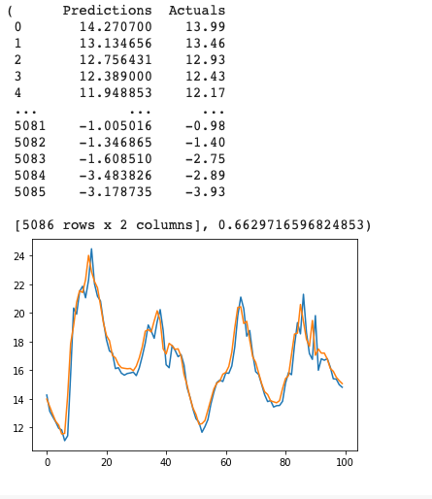
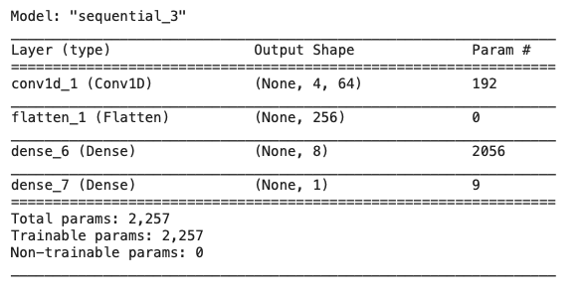
module 1
CNN model architecture
Data before
CNN model architecture
data trained for 10 epochs
data trained for 10 epochs

Slide 9
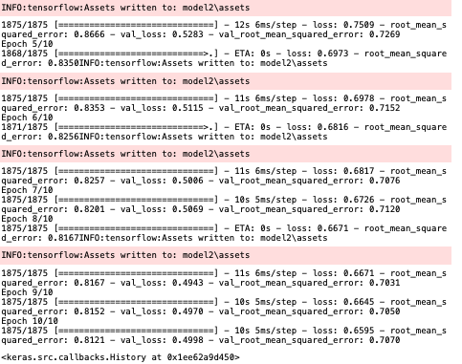
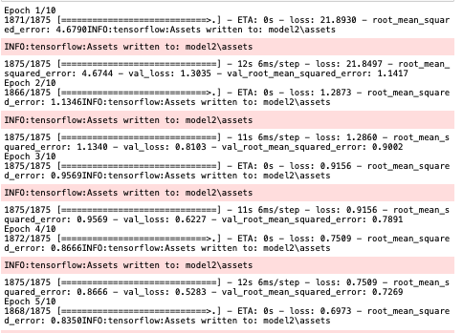
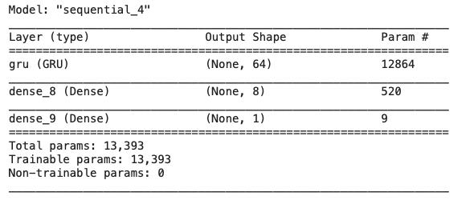
module 2
GRU intializationmodel architecture
CNN model architecture
Running train data GRU
Running train data GRU
data trained for 10 epochs

Slide 10
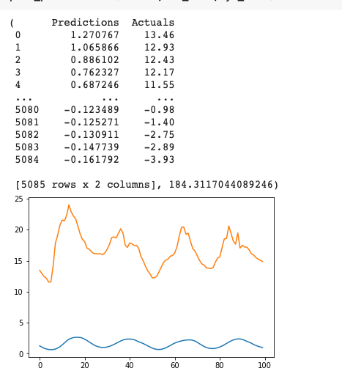
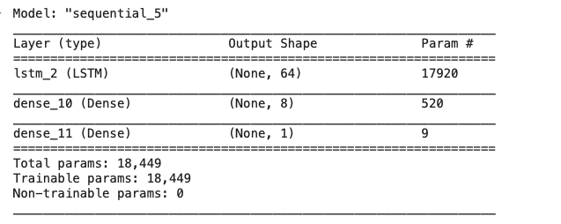
module 3
LSTM data initialization
Training data

Slide 11

THE BUTTER MODULES
i suggest to Start with LSTM,
as weather data typically has long-term dependencies due to seasonal trends. If training time or computational resources are limited, switch to GRU. Use CNN only if the focus is purely on short-term, localized trends.

Slide 12

CONCLUSION
In conclusion, This article demonstrates the usage of Deep Learning Model for Time-Series Forecasting. This makes LSTM the perfect candidate for modeling long-term patterns such seasonal trends in weather data. If resources are sparse, GRU is a better choice, while CNN is useful for predicting short term trends.
These techniques prove beneficial in different systems because the correct model can enhance forecasting accuracy

